Slide 1
Data Storytelling for Financial Advisors
A concise review of dataset structure, trends, and business-ready recommendations

Slide 2
EDA Approach and Focus
Explored core business questions and dataset health
Segmented observations by case status, employment type, experience, and education
Focused on patterns relevant to financial planning, compliance, and operational risk

Slide 3
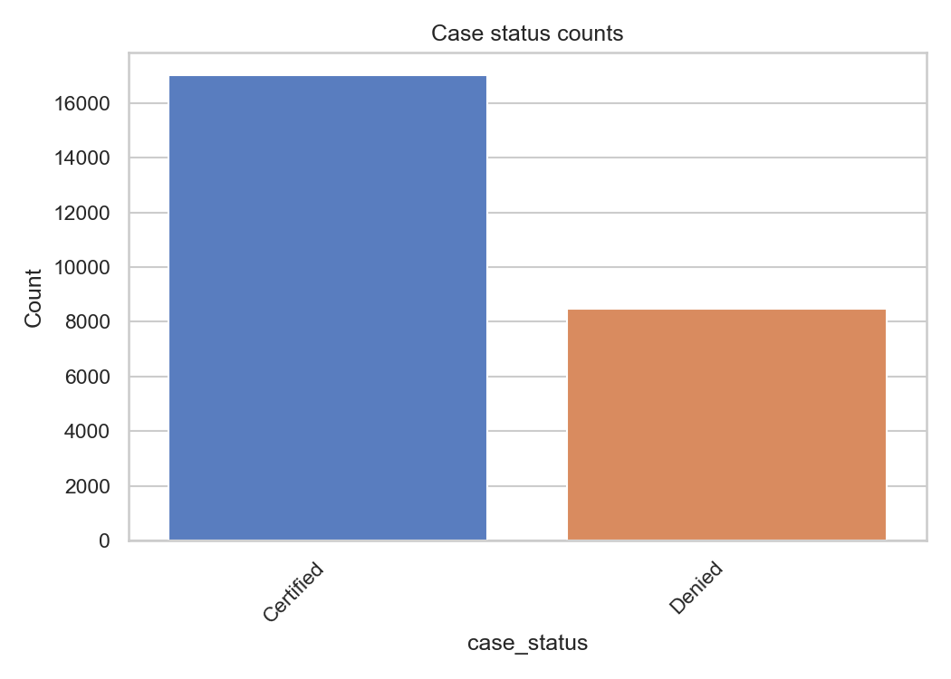
Case Outcome Trends

Slide 4
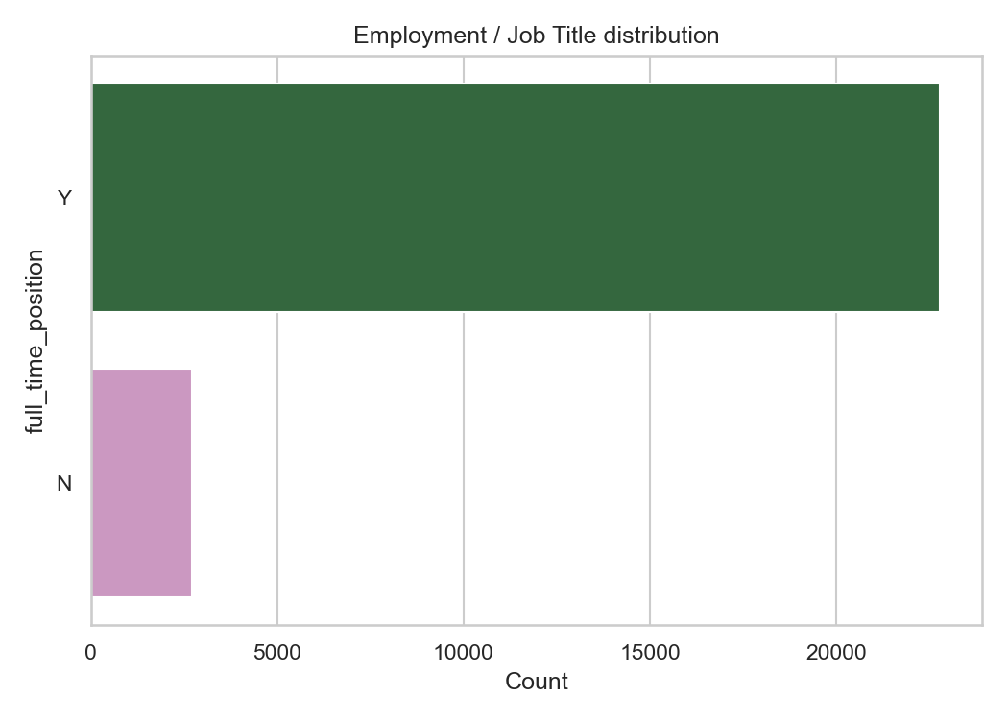
Employment and Resource Profile

Slide 5
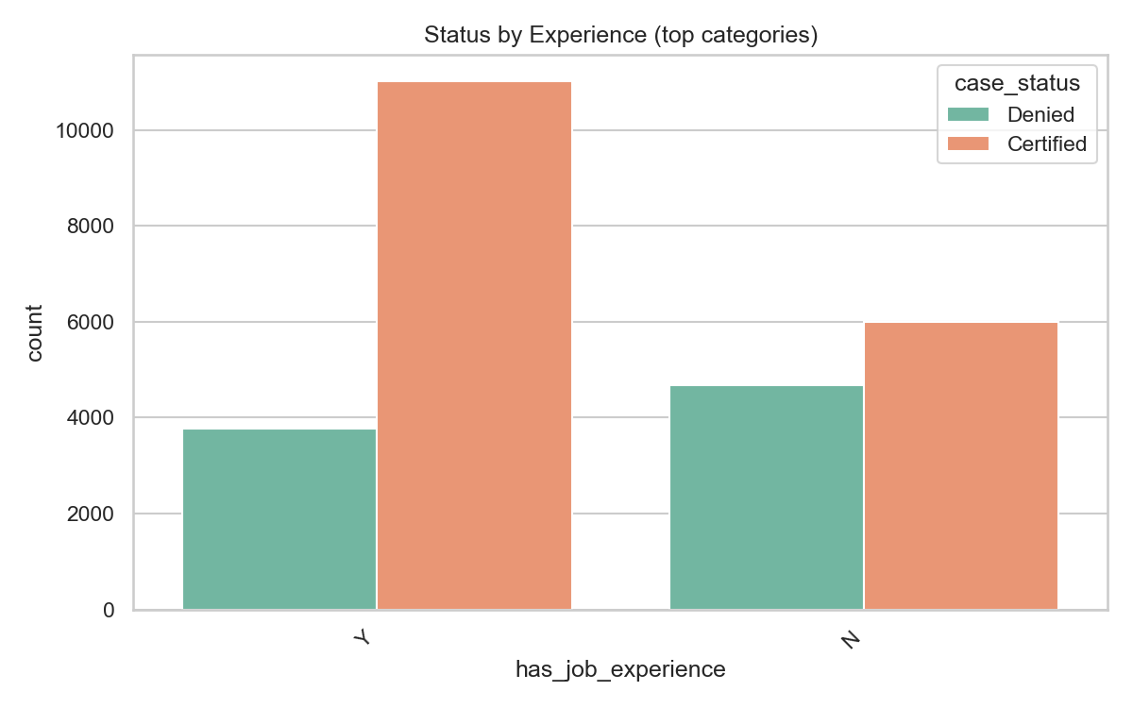
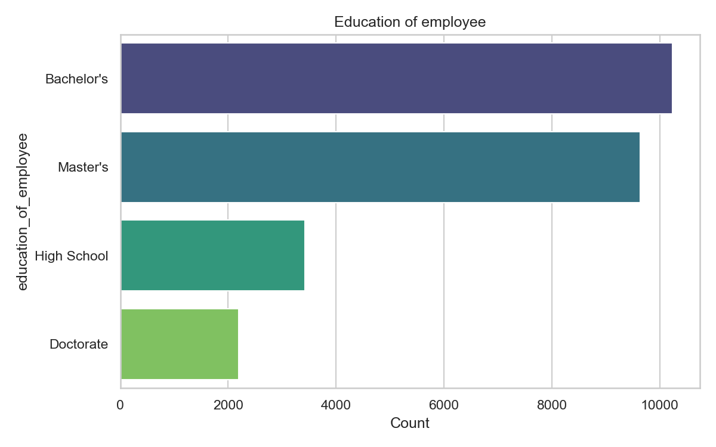
Experience and Education Patterns

Slide 6
Key Risk and Opportunity Signals
High-level insights for advisors and hiring managers
A strong majority of positive outcomes are associated with structured employment pathways
Experience and education distribution suggests opportunity for targeted upskilling
Monitoring case/status mix can help reduce operational exposure and improve forecast accuracy

Slide 7
Actionable Recommendations
Recommended focus areas for financial advisory and employer readiness
Use dashboarding on outcome status and employment type to spot process bottlenecks
Align training investment with the most common education and experience cohorts
Build narrative summaries around successful applicant profiles and risk controls

